Slide 1


Project 2 report

Slide 2
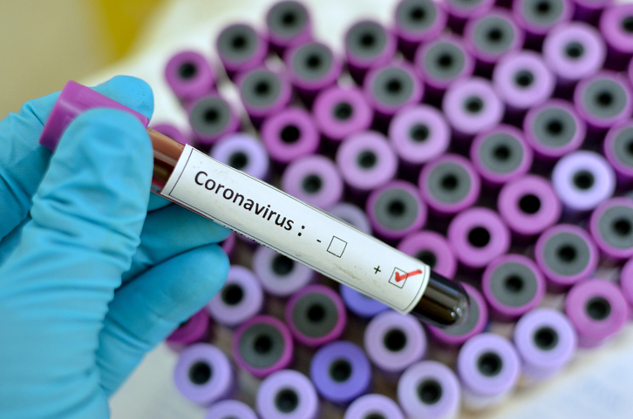


Agenda
Introduction
Individual Work
Moment of Truth

Slide 3
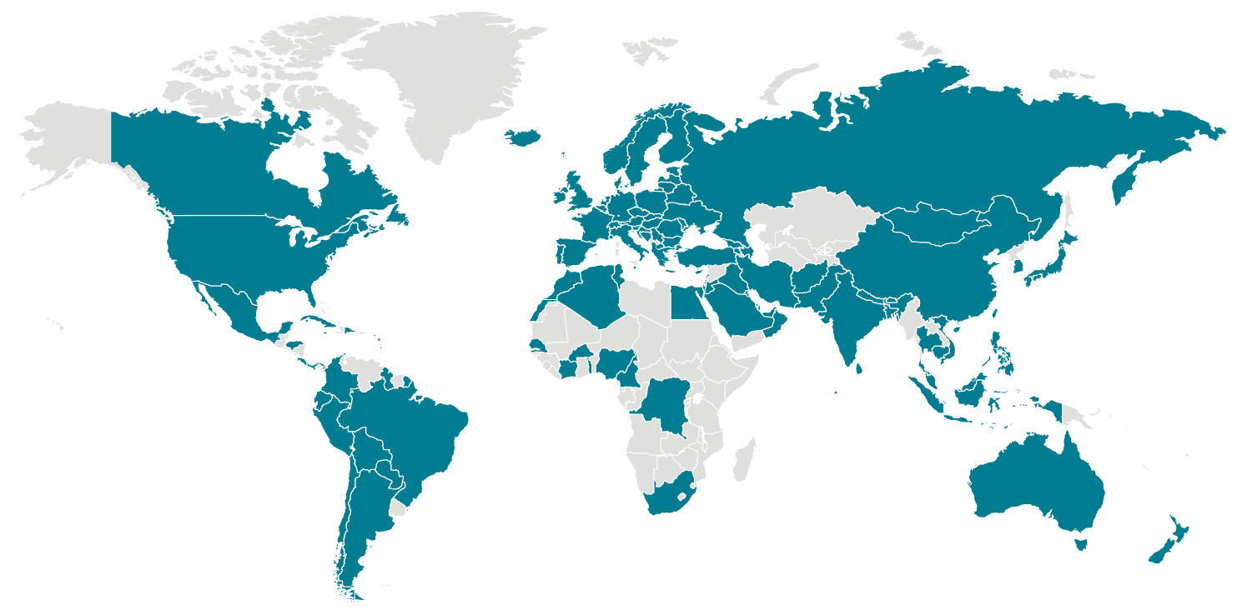
Locations with Confirmed COVID-19 Cases
Global Map
As of 12:00 p.m. ET March 11, 2020
https://www.cdc.gov/coronavirus/2019-ncov/locations-confirmed-cases.html

Slide 4
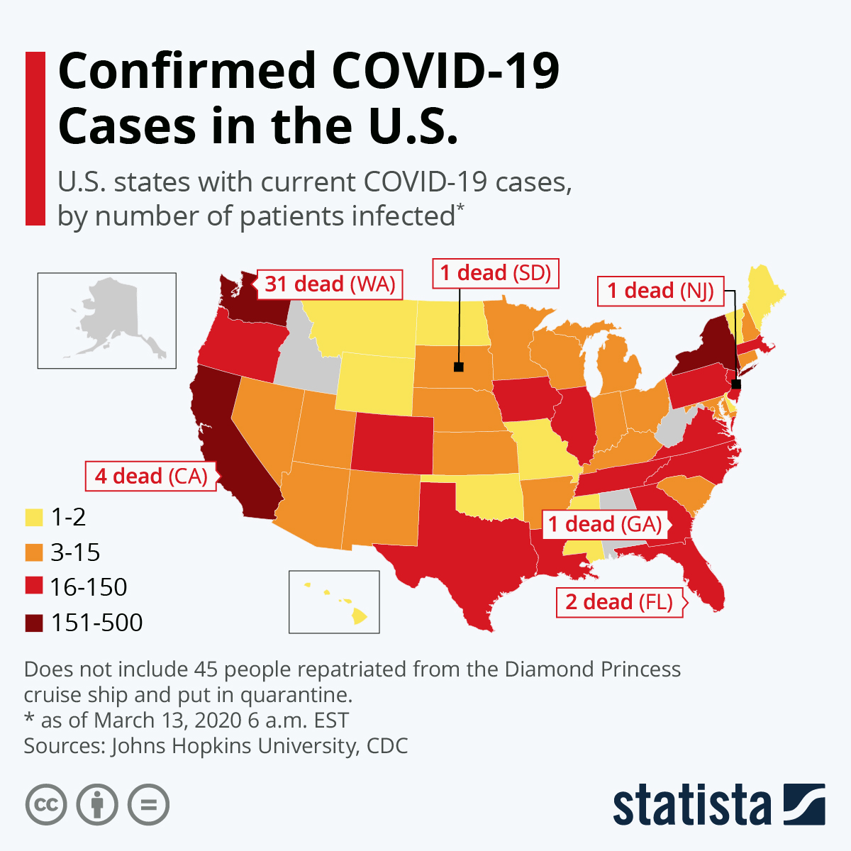
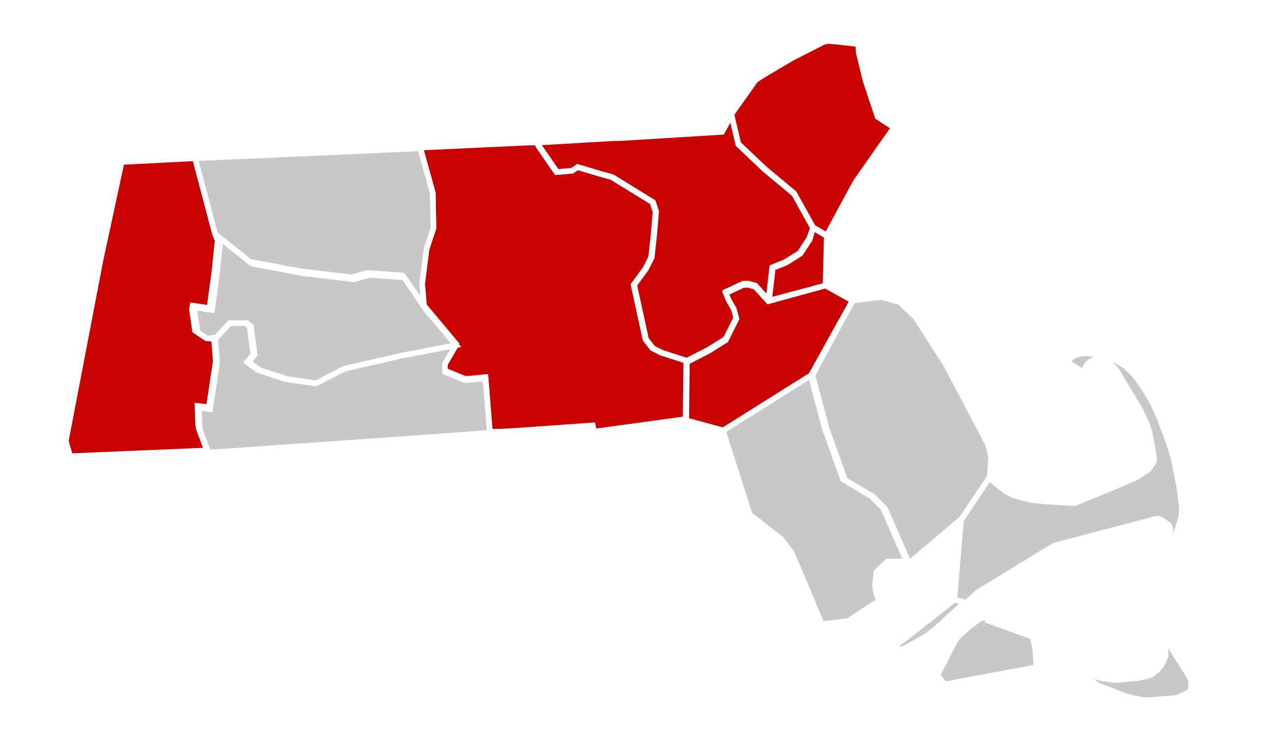
2020 coronavirus pandemic in Massachusetts
https://en.wikipedia.org/wiki/2020_coronavirus_pandemic_in_Massachusetts

Slide 5
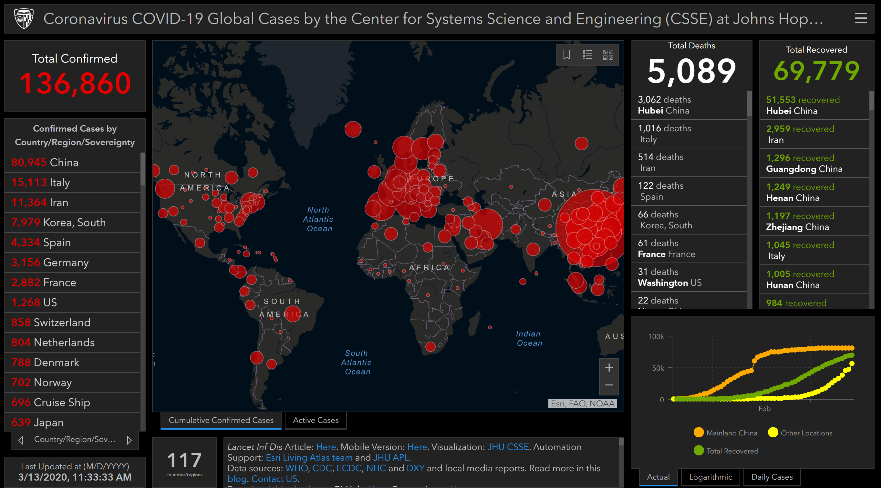
https://www.arcgis.com/apps/opsdashboard/index.html#/bda7594740fd40299423467b48e9ecf6

Slide 6

Our Team & individual work
Emma
Souky
Jin
Julie
ETL data into MongoDB/PostgreSQL database
Map interaction
Webpage layout
Interaction
Charts visualization
Reports and PPT
Integration

Slide 7
Emma: ETL data into MongoDB/PostgreSQL database
ETL
Used Kaggle.com as primary source for COVID data and John Hopkins’ github for later days of most recent
Data Transform: Cleaned the csv
Load: Input into pgAdmin4 and then utilized Python sqlalchemy
For the project, 4 json files were created:
To show the confirmed cases by date
To display recovered, deaths, and confirmed by date and country
A list for latitudes and longitudes by country
A view for all the data shown in our SQL main table

Slide 8
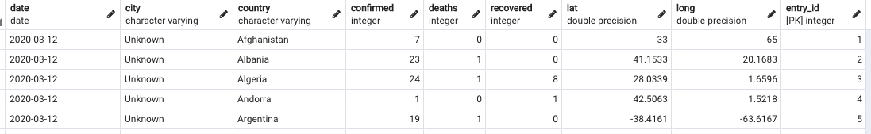
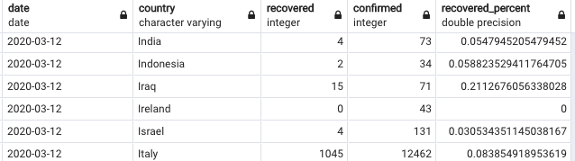
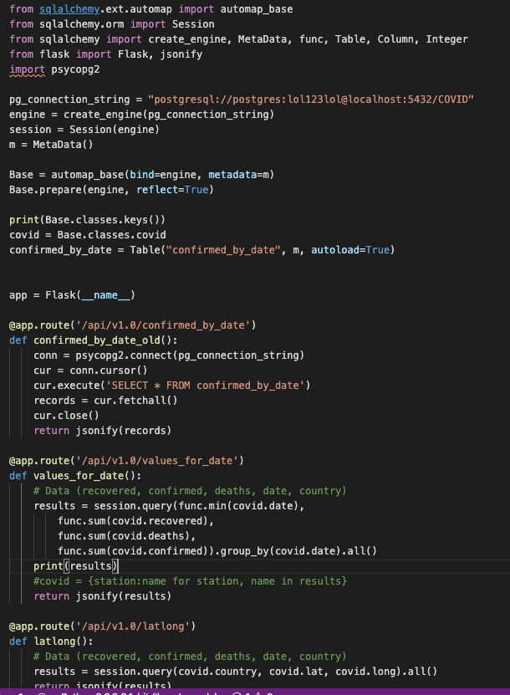
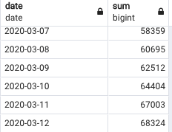
Emma: ETL data into PostgreSQL database
SQL
FLASK

Slide 9
Emma’s challenges
It was difficult cleaning the data because not everything was consistent within the csv file. Some countries linked to information prior to mid-February were missing lat/long data and a good chunk of countries did not have its corresponding city/state. I had to clean the information twice because we had two rounds of ETL. Once for testing at the beginning of the project and a second time for the final display, with the most recent updates included. There were definitely more efficient ways to clean the csv than what I did but due to time-constraints, I fell back on what I knew worked well for me. Had there been more time, I would have used Panadas and VBA to automate the cleaning process.
Json was challenging for me. At first, I really did not understand because that package is a weak point of mine. After much troubleshooting on my own and help from Paolo, I was able to work out the code.

Slide 10
Souky: Map interaction &Integration
I used Leaflet library to create the visual map plotting the data converted to geojson format.
To describe the cases in each province I used the Feature that works perfectly to describe features with a set of properties.
I also used the function onEachFeature option to attach a popup to features when they are clicked.

Slide 11
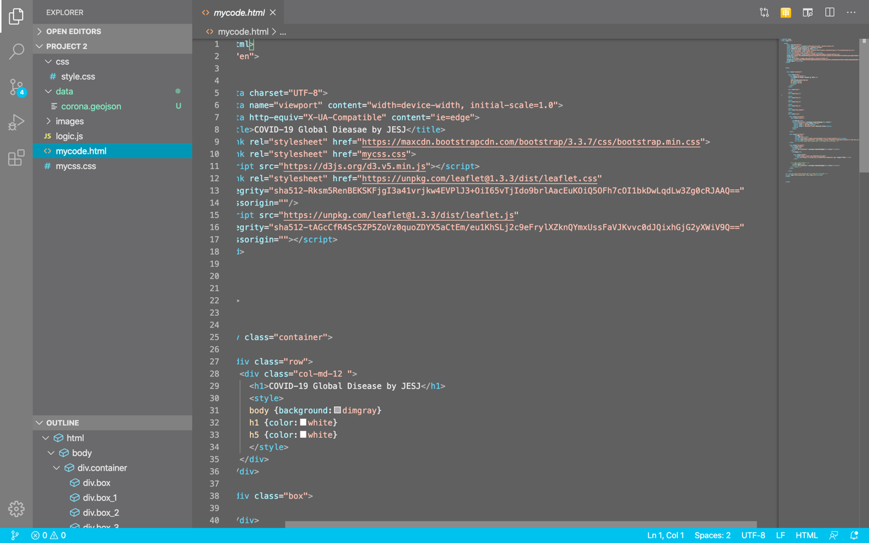
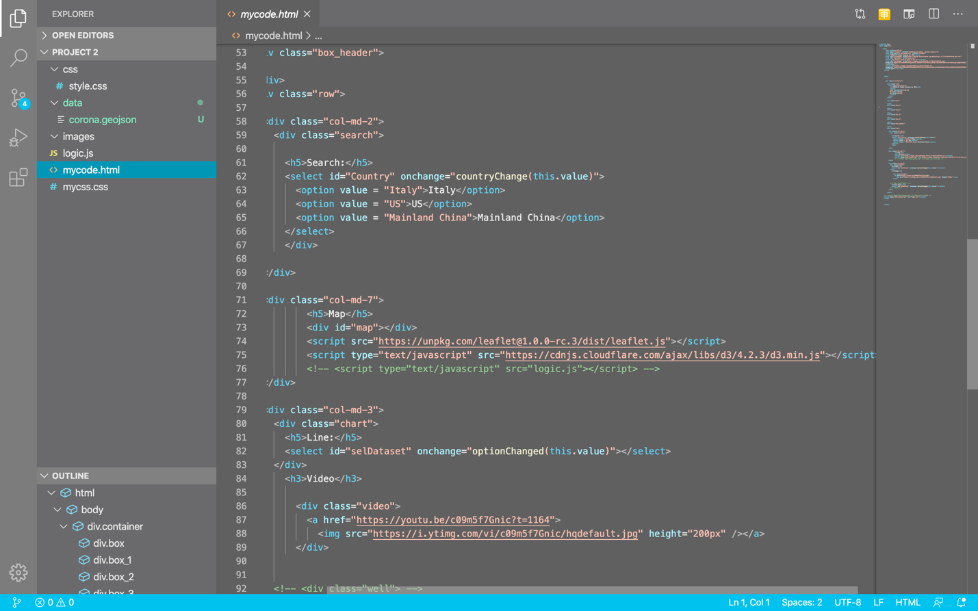
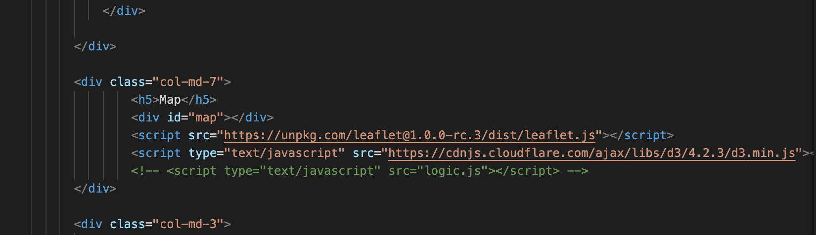
Souky: Map interaction & Integration
.js
.html

Slide 12
Jin: Webpage layout & Interaction
Webpage setup: HTML/CSS
Tool used: Bootstrap
Interact map, charts, and video into webpage
Create drop down list
Turned csv into geojson file
On JavaScript, use d3 read into geojson
Create an array and link it to html
Display the total cases
Tool used: Infor gram

Slide 13
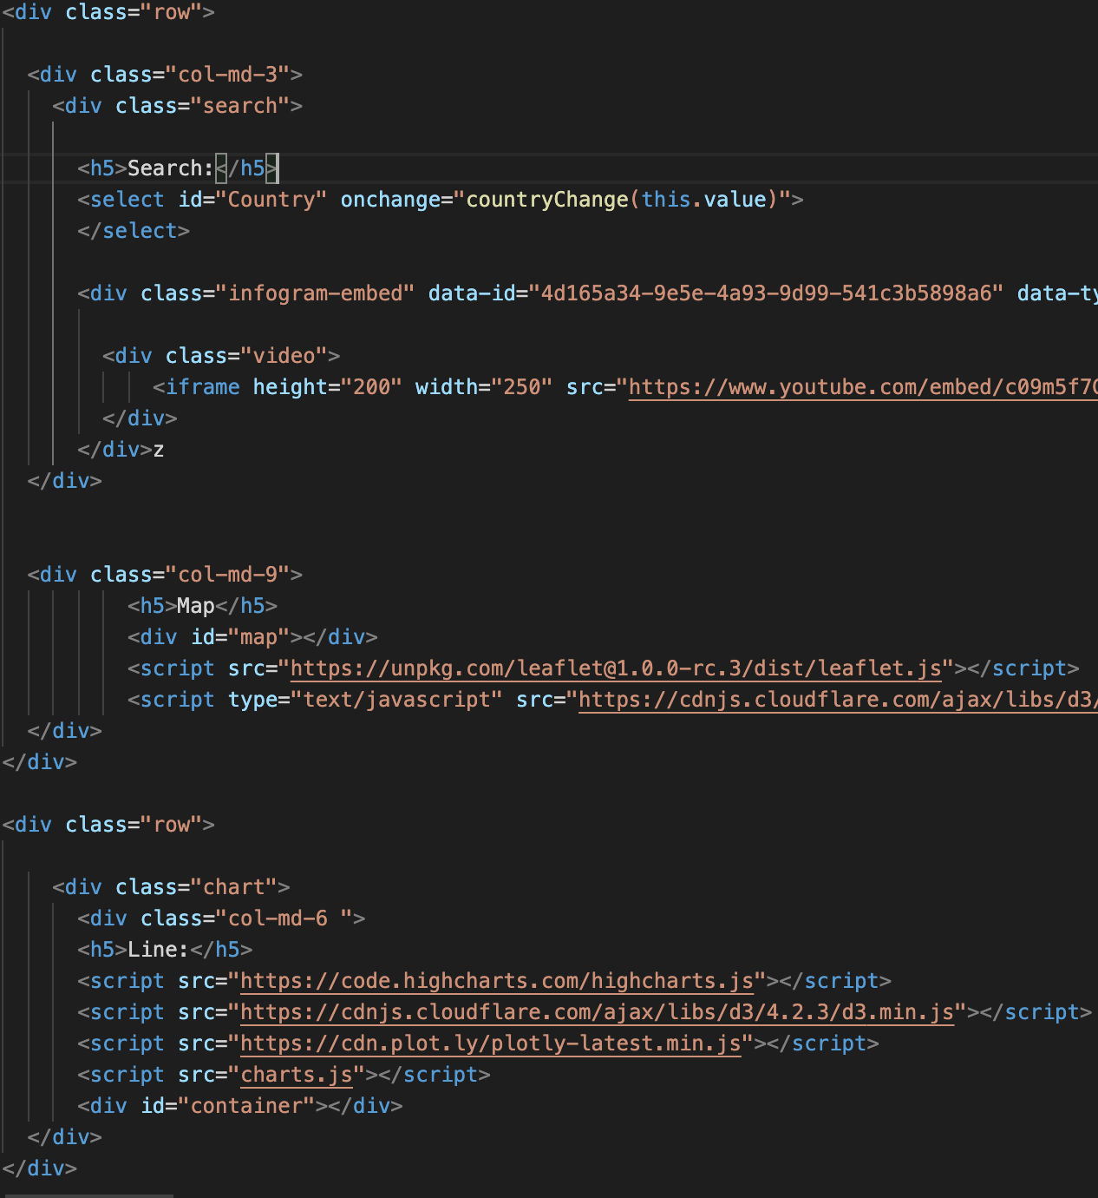
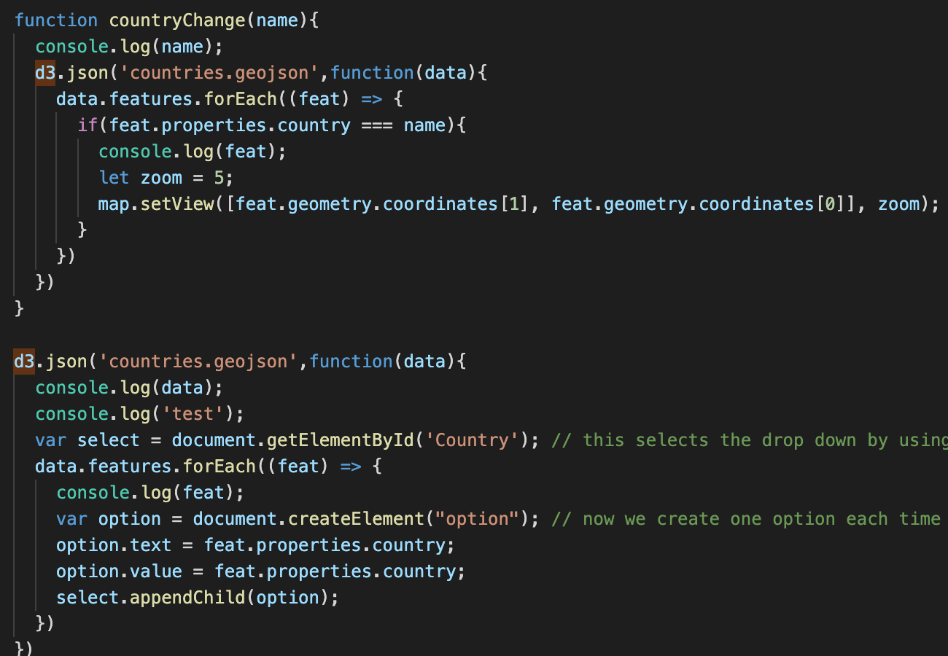
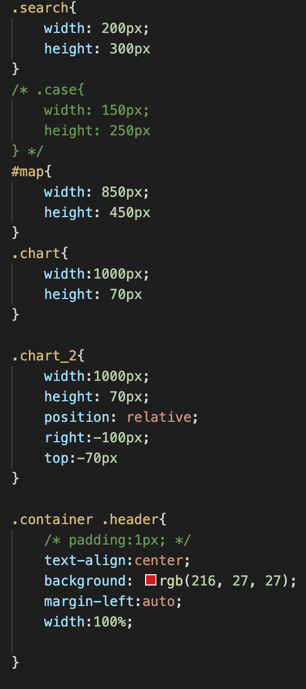
HTML & CSS & JavaScript

Slide 14
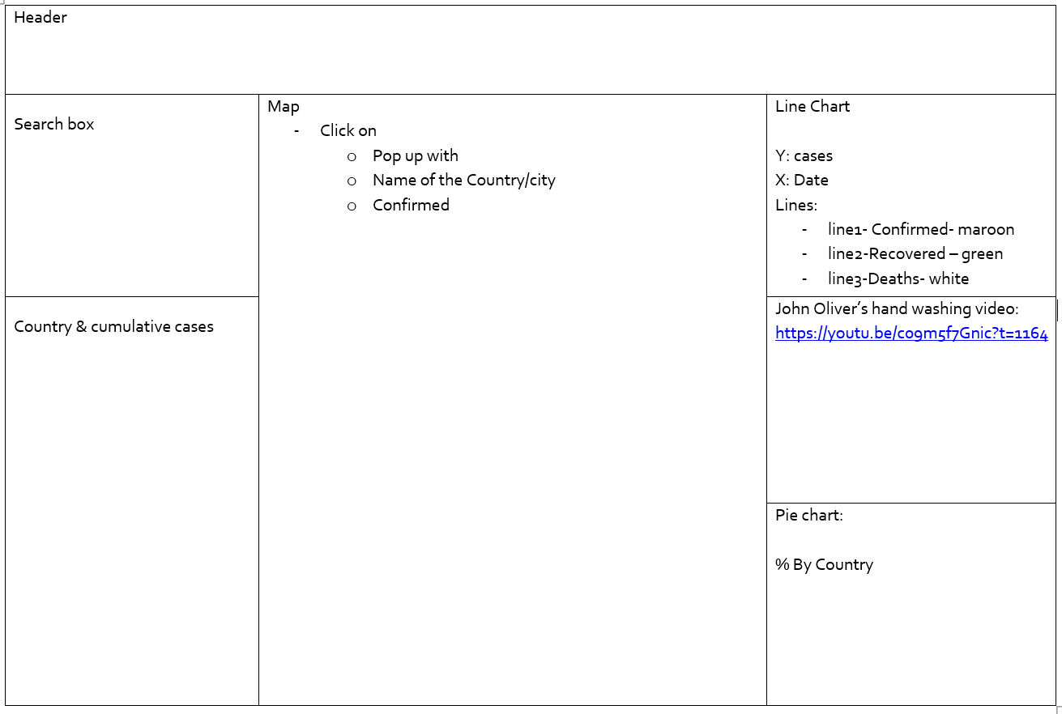
Jin’s challenges
Our Sketch on Day 1………

Slide 15
Julie: Charts Visualization and more
Charts visualization
Researching new library in js
Tried highchart, chart.js and more..
Data analyzing :
Case Status through dates
Mortality rate by countries
Tools: D3, plotly and highchart( do not recommended..)
Project related: proposal, dash boardsketch and report

Slide 16
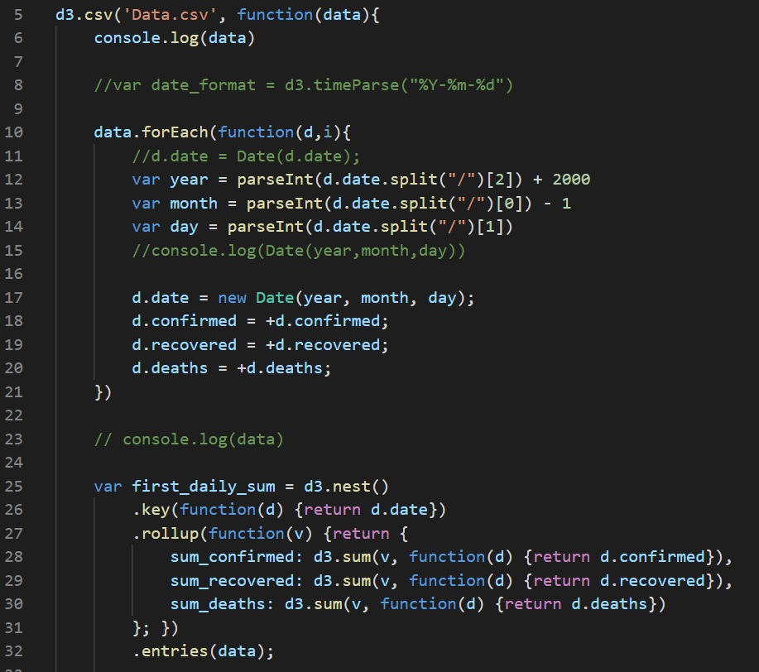
Julie: Charts Visualization and more
Highchart & plotly

Slide 17
Julie’s challenges
Time
The dashboard looks pretty straightforward but when it come to build our own, it turns out way more complex.
tools
Trying out new js libraries with the given time is very challenge. Failed few of them but good lessons were learnt.
Expectation management
Our team have a lot of great ideas. With the expectation management, we could be more focus on what we can achieve within the time frame.

Slide 18
Moment of truth (with dashboard screenshot)

Slide 19


Slide 20

Thank You and try not touching your face

